Slide 1
DevOps Champions: Leading the Transformation
Tyler Underwood
Quicken Loans

Slide 2


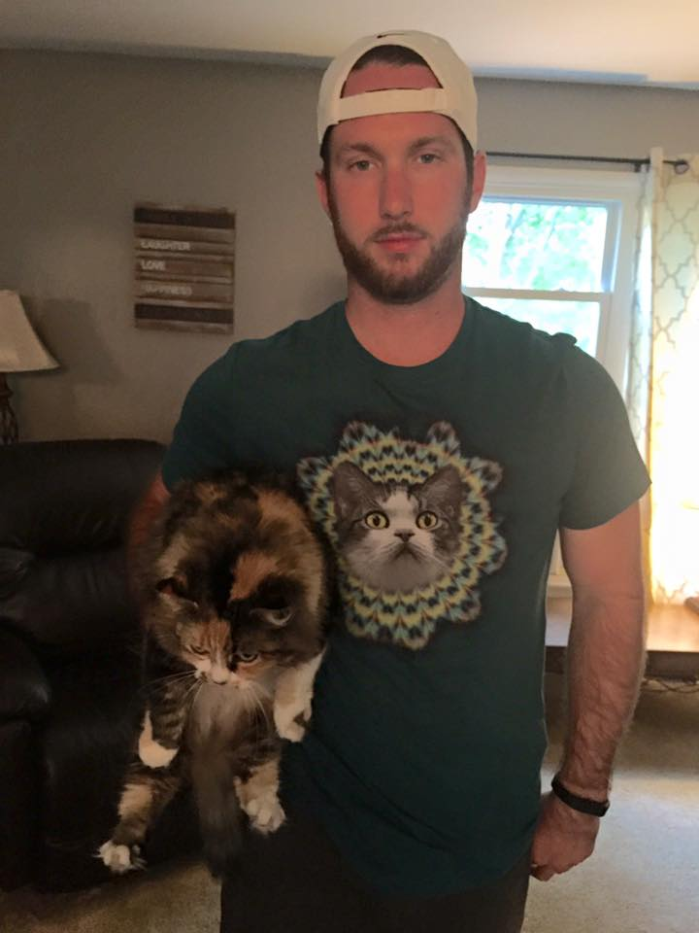
Who am I?
Notes:
About me: I really enjoy Christmas and off-the-wall outfits
Don’t really like cats, but seem to be surrounded by them
Senior Application Engineer at QL
QL is a financial organization – very large, complex organization – a lot of sensitive data → security and compliance are very important

Slide 3
Discussion Topics
Value Stream Mapping
Three Principles of DevOps
Scaling DevOps in large organizations
How to start the movement?
Common failures and lessons learned
Notes:
The Three Principles is a framework that is underlined in the Phoenix Project

Slide 4










Ops
DevOps
Quality Assurance
Dev
System Admin

Slide 5
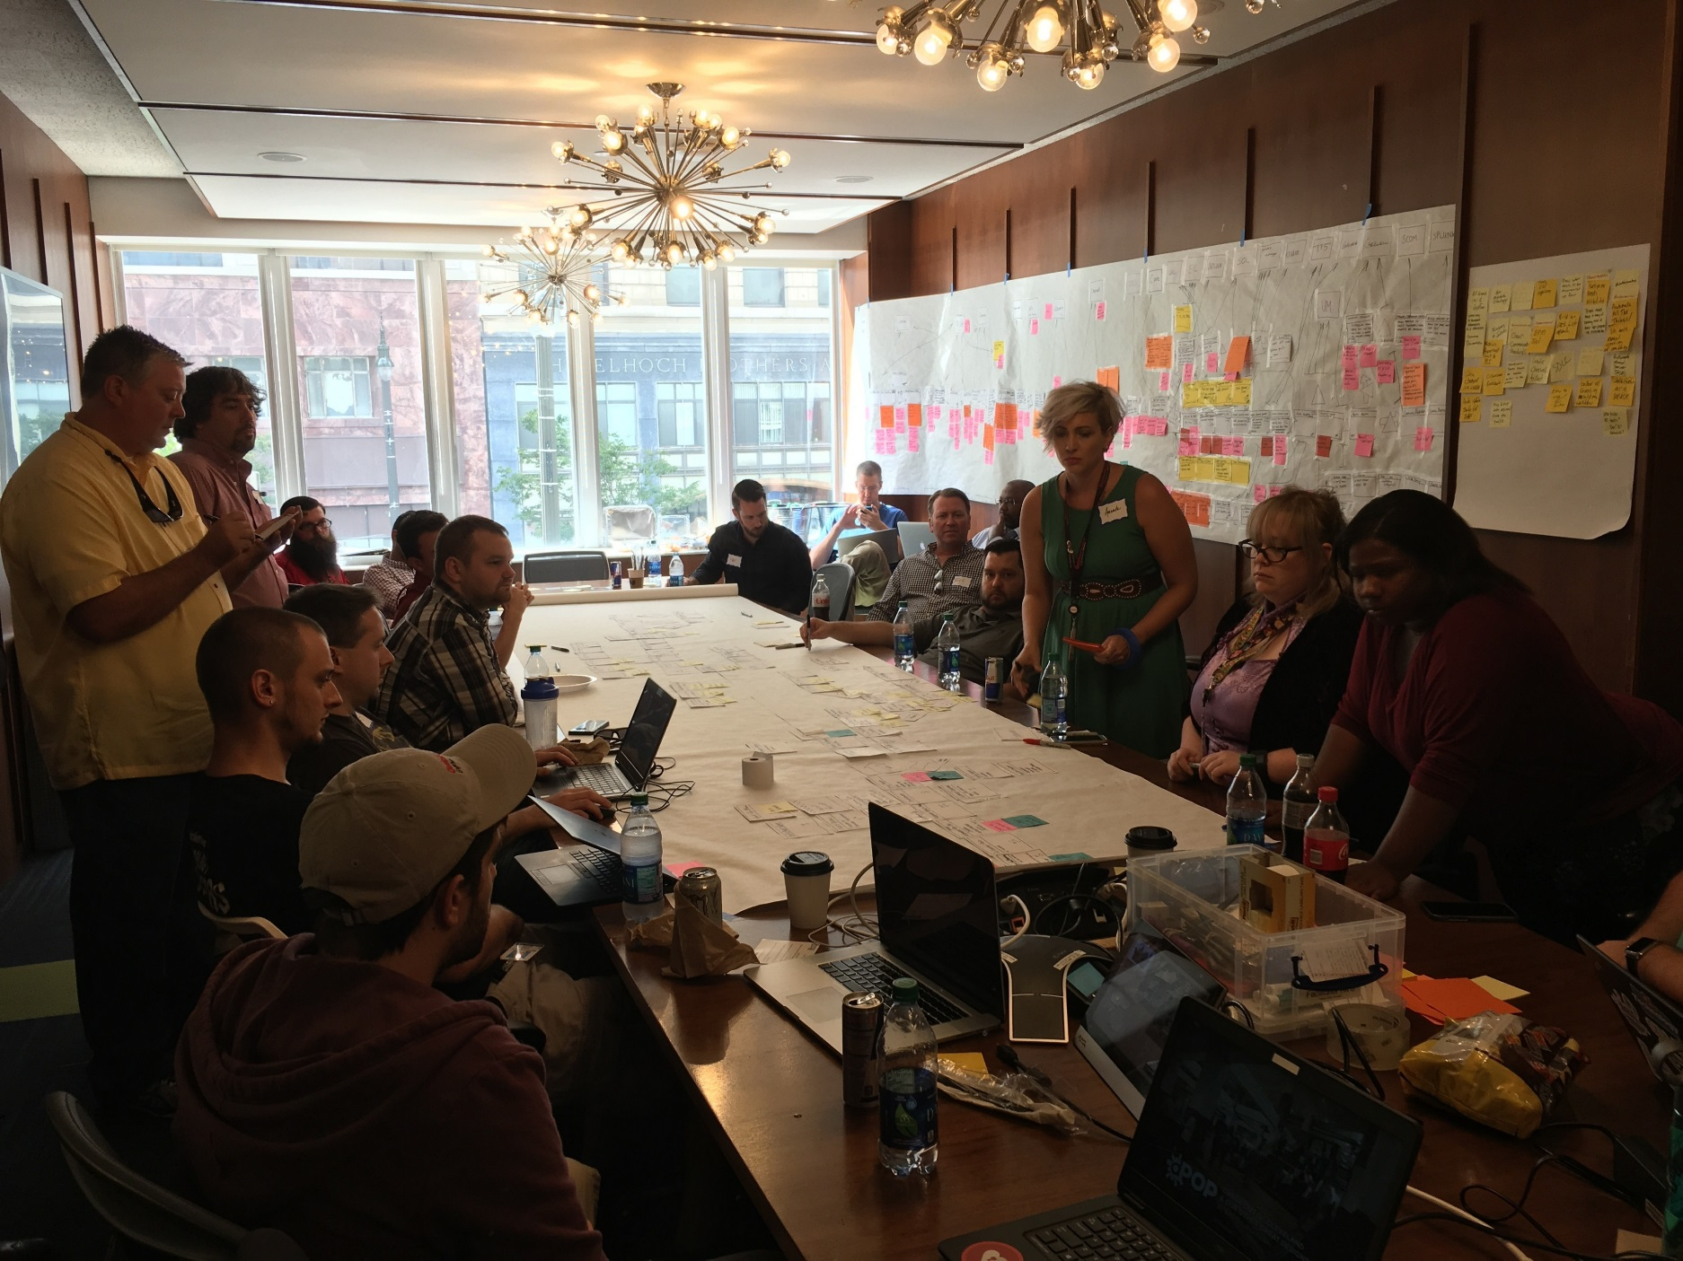

Slide 6
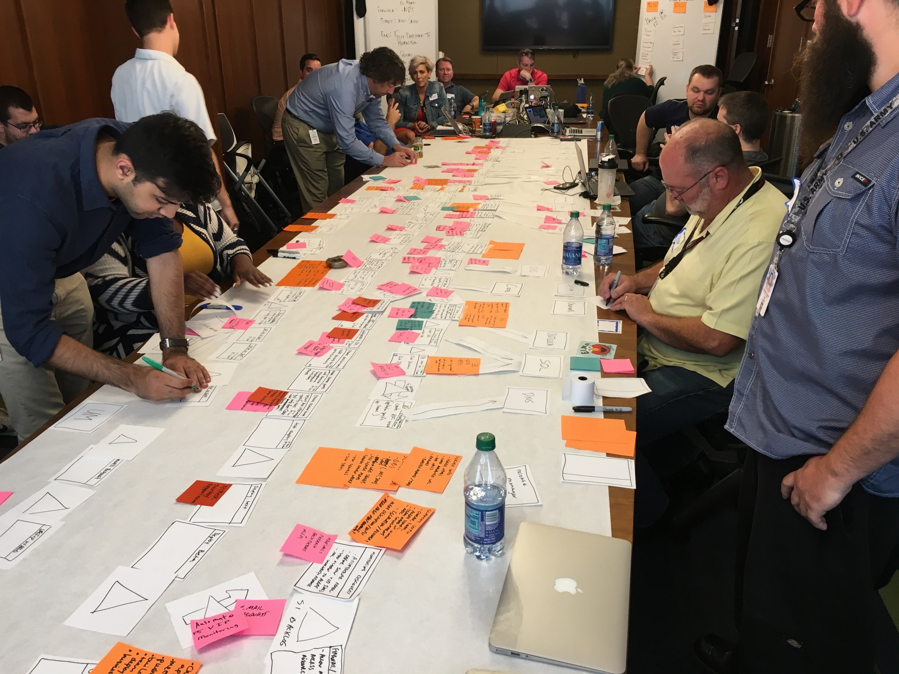

Slide 7
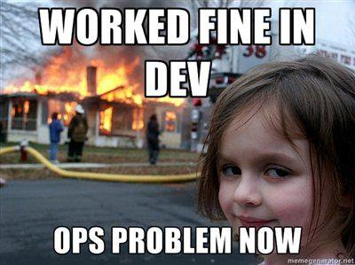

Slide 8
DevOps! = Outlined Process
The Three Ways: The Principles Underpinning DevOps
Systems Thinking
Amplify Feedback Loops
Culture of Continual Experimentation and Learning

Slide 9


The Three Ways: System Thinking
SDLC
Pipeline
Value Stream
Bugs
(Business)
(Client)
Dev
Ops

Slide 10
Deploy Code Request
Gateway 1
Gateway 2
Cloud
Gateway 1
Code Deployment
Gateway 1
Gateway 2
Gateway 2
Cloud

Slide 11
Deploy Code Request
Gateway 1
Gateway 2
Code Deployment
Gateway 1
S3 Bucket Repo
Gateway 2
Cloud

Slide 12
Cut Deployment Time 97%

Slide 13

The Three Ways: Systems Thinking

Slide 14
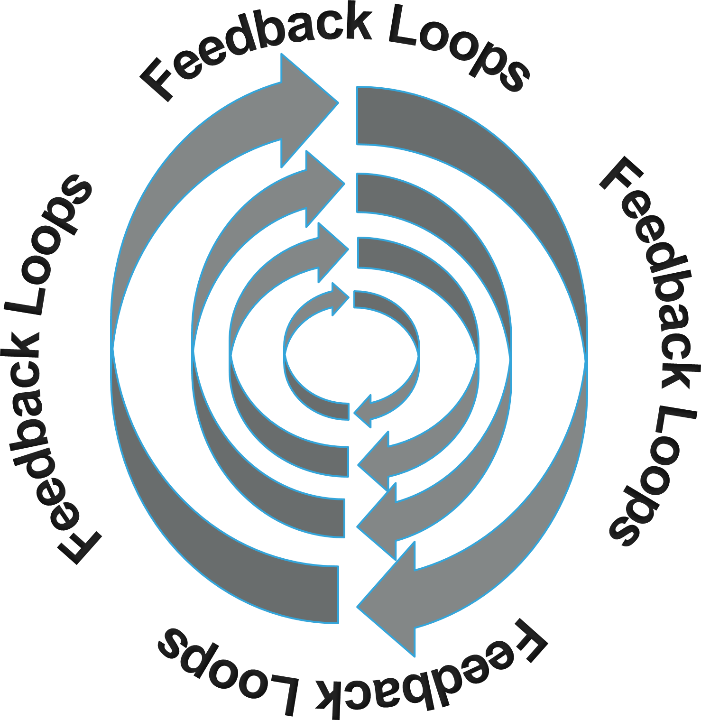
The Three Ways: Amplify Feedback Loops

Slide 15
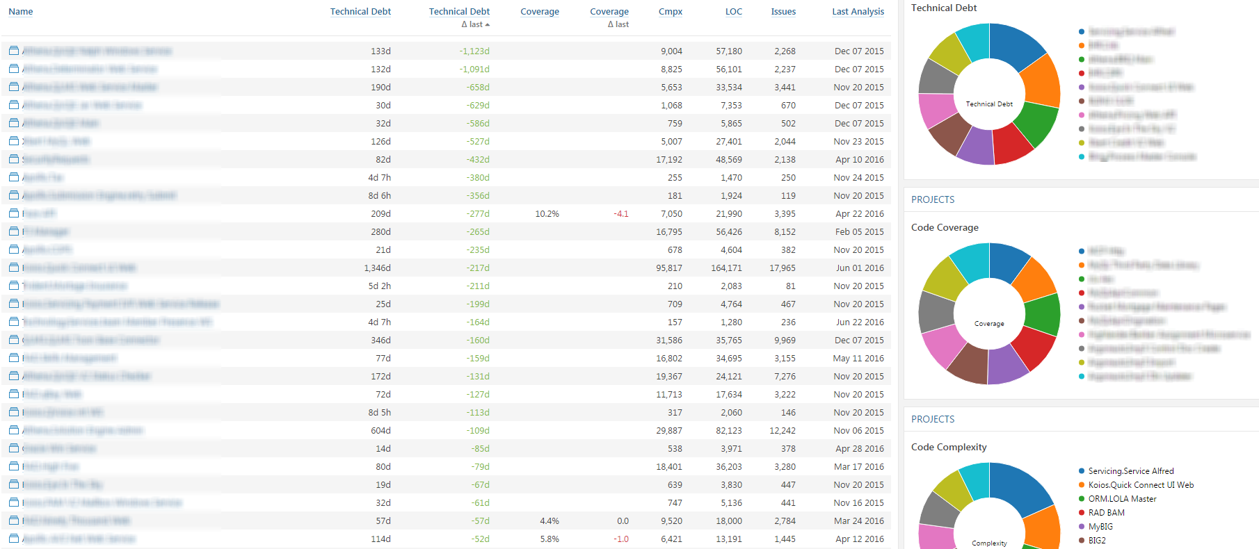

Slide 16

Code Coverage = 98%
Deploy To Beta!
Developer Autonomy?

Slide 17
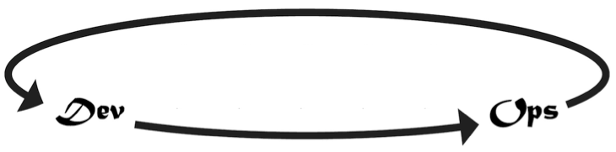
The Three Ways: Amplify Feedback Loops
Agile Coaches
Standups
Retros
Planning
Quality Feedback

Slide 18

The Three Ways: Continual Experimentation & Learning
Continuous Experimentation
Failures
Risks
Repetition
Practice

Slide 19

The Three Ways: Continual Experimentation & Learning
Risk vs. Reward
Dev
Ops

Slide 20

The Three Ways: Continual Experimentation & Learning
Orientate
Current Situation
Identify Future State
Make Changes
Evaluate Results
Kaizen

Slide 21
The Three Ways: Continual Experimentation & Learning
Performing an action more than twice →AUTOMATE!
Identify success criteria on the front-end
Focus on the outcome and iterate

Slide 22
The Three Ways: Let’s Recap
Systems Thinking
Amplify Feedback Loops
Culture of Experimentation & Learning

Slide 23

DevOps Team

Slide 24


Dev
Ops
DevOps
Community
Business Analyst
Quality Assurance
Leadership
System Admin

Slide 25
DevOps! = One Single Team
Lessons Learned
DevOps methodologies to be adopted across the enterprise
Everyone from developers to operations need to understand how the other works
Providing visibility to all breaks down silos
Leadership buy-in of the Three Ways Principles

Slide 26
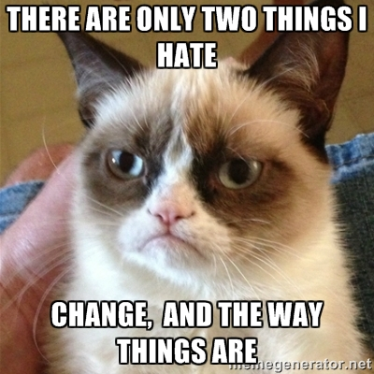

Slide 27
DevOps = Build + Deploy

Slide 28
DevOps! = Build + Deploy
Coaching on best practices early
Testing procedures to allow for code coverage
Application creation process
Metadata captured
Infrastructure as code
Self-service provisioning
Risks

Slide 29
Final Thoughts
Deployment strategy is important, not everything
Continuous Integration, Continuous Deployment, Continuous Delivery
DevOps bridges the gap between Dev and Ops
“DevOps Champions” are important, but not all that is needed
DevOPs! = Automation. Automation is the natural result of DevOps

Slide 30
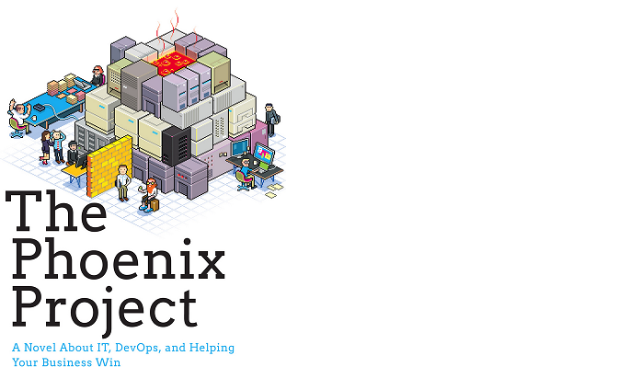
Sources & Recommended Content
http://itrevolution.com/the-three-ways-principles-underpinning-devops/
https://kaizeninstituteindia.wordpress.com/2013/05/28/yokoten/
http://www.infoworld.com/article/3087447/devops/real-world-devops-failures-and-how-to-avoid-them.html
The Phoenix Project – A Novel about IT, DevOps, and Helping Your Business Win

Slide 31

Questions?

Slide 32
Thank You!
Tyler Underwood
Sr. Application Engineer
Quicken Loans

